Slide 1
CIS 11 – Computer Architecture
James Wilson

Slide 2
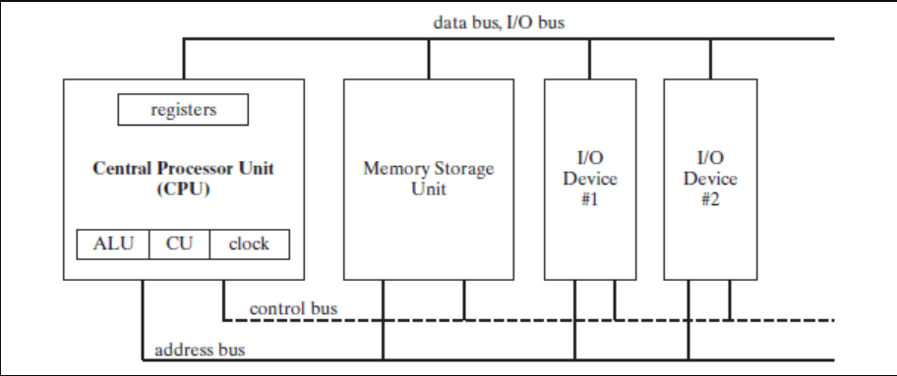
General Concepts of Microcomputer Design
CPU
Registers
ALU
CU
Clock
Buses
Data bus
Control bus
Address bus
Memory

Slide 3
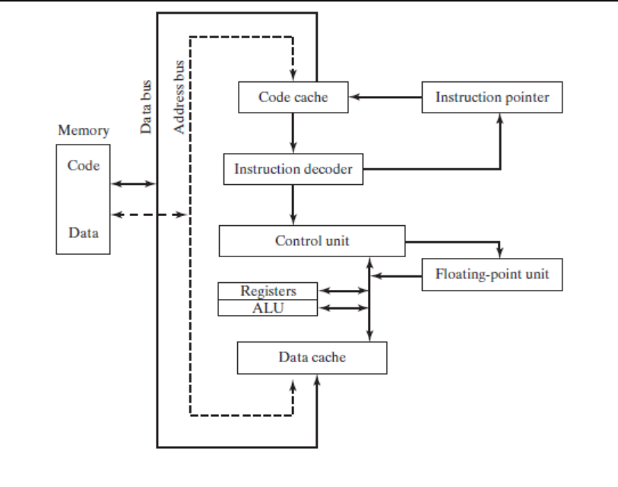
Instruction Execution Cycle
Fetch
Decode
Execute
(optional) Store

Slide 4
Reading From Memory (page 36)
Static RAM
Dynamic RAM
Caching
Cache Hit
Cache Miss
http://www-mdp.eng.cam.ac.uk/web/library/enginfo/mdp_micro/lecture1/lecture1-3-2.html

Slide 5
X86 Components
Motherboard
CPU socketer
Memory slots
BIOS
CMOS
Peripheral connectors
Memory
ROM
EPROM
DRAM
SRAM
VRAM
CMOS

Slide 6
Input-Output
Levels of I/O Access
HLL
OS
BIOS
Application Program
OS Function
BIOS Function
Hardward

